Slide 1

Types of Testing
By – Kavita Patel

Slide 2
Agenda :
What is Testing
Functional and Non-Functional Testing
Black Box Testing Techniques
Techniques of Black box testing
White Box Testing Techniques
Experience Based Testing Techniques
Smoke and Sanity Testing
Re-Testing and Regression Testing
End to End Testing
Positive and Negative Testing
Maintenance Testing

Slide 3
What is Testing
Software Testing is a method to check whether the actual software product matches expected requirements and to ensure that software product is Defect free.
Software Testing is necessary because we all make mistakes. Some of those mistakes are unimportant, but some of them are expensive or dangerous. We need to check everything and anything we produce because things can always go wrong – humans make mistakes all the time.

Slide 4
Functional and Non-Functional Testing
Functional testing verifies each function/feature of the software whereas Non Functional testing verifies non-functional aspects like performance, usability, reliability, etc.
Functional testing is based on customer’s requirements whereas Non Functional testing is based on customer’s expectations.
A Functional Testing example is to check the login functionality whereas a Non Functional testing example is to check the dashboard should load in 2 seconds.
Functional describes what the product does whereas Non Functional describes how the product works.
Functional testing is performed before the non-functional testing.

Slide 5
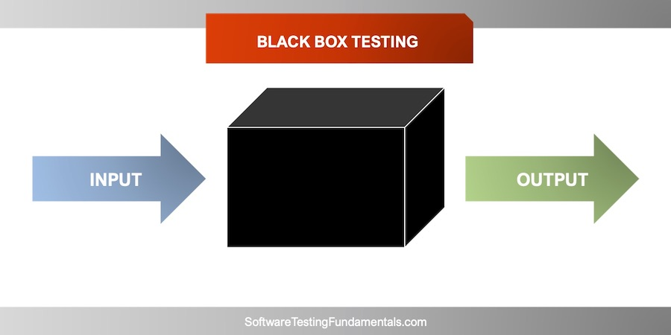
Black Box Testing Techniques

Slide 6
Black Box Testing Techniques
Black-box testing: Testing application without reference to the internal structure of the component or system.
The testers have no knowledge of how the system or component is structured inside the box.
A Tester will interact with the system's user interface by providing inputs and examining outputs without knowing how and where the inputs are worked upon.

Slide 7
Techniques of Black Box Testing
Equivalence partitioning(EP)
Boundary value analysis(BVA)
Decision tables
State transition testing
Use-case Testing

Slide 8
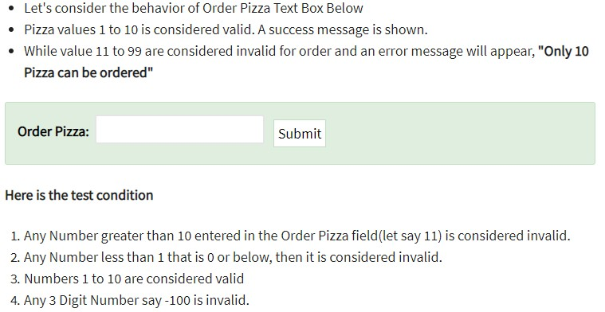
Equivalence partitioning(EP)

Slide 9
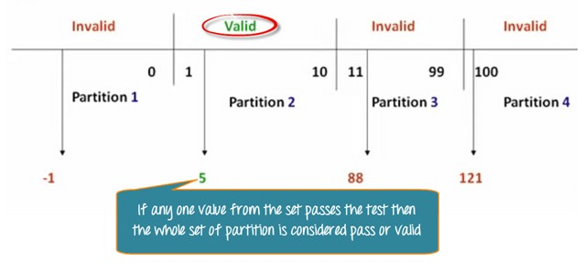

Techniques of Black Box Testing

Slide 10
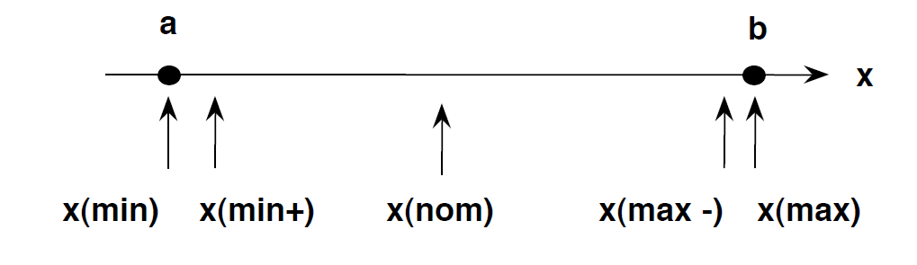
Boundary Value Analysis(B.V.A.)
The process of testing between extreme ends or boundaries between partitions of the input values.
So these extreme ends like Start- End, Lower- Upper, Maximum-Minimum, Just Inside-Just Outside values are called boundary values and the testing is called "boundary testing".
The basic idea in boundary value testing is to select input variable values at their:
Minimum
Just above minimum
A nominal value
Just below maximum
Maximum

Slide 11
Boundary Value Analysis(B.V.A.)

Slide 12
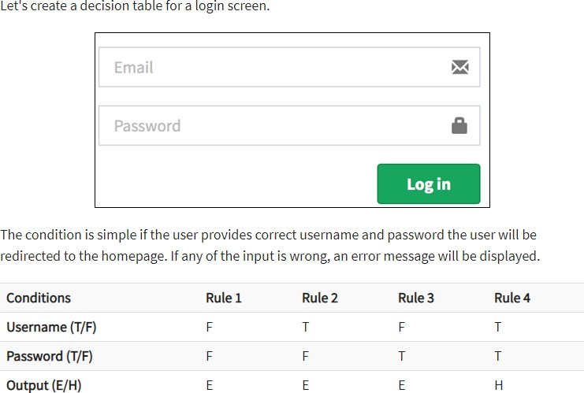
Decision Table Example

Slide 13
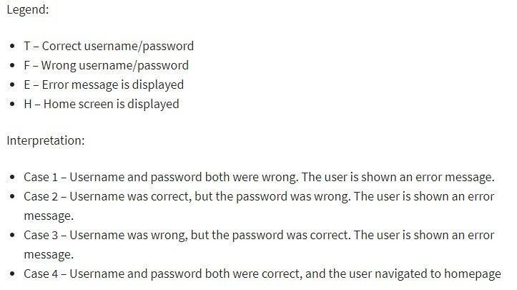
Decision Table Example

Slide 14
State Transaction Testing
State Transition Testing uses the following terms:
State Diagram: A diagram that depicts the states that a component or system can assume, and shows the events or circumstances that cause and/or result from a change from one state to another. [IEEE 610]
State Table: A grid showing the resulting transitions for each state combined with each possible event, showing both valid and invalid transitions.
State Transition: A transition between two states of a component or system.
State Transition Testing: A black box test design technique in which test cases are designed to execute valid and invalid state transitions. Also known as N-switch testing.

Slide 15
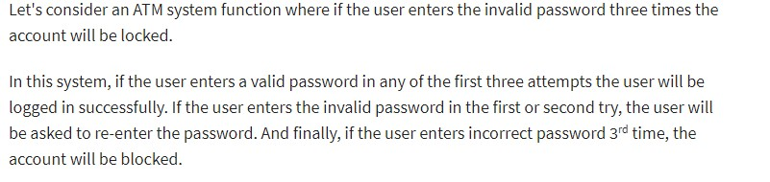
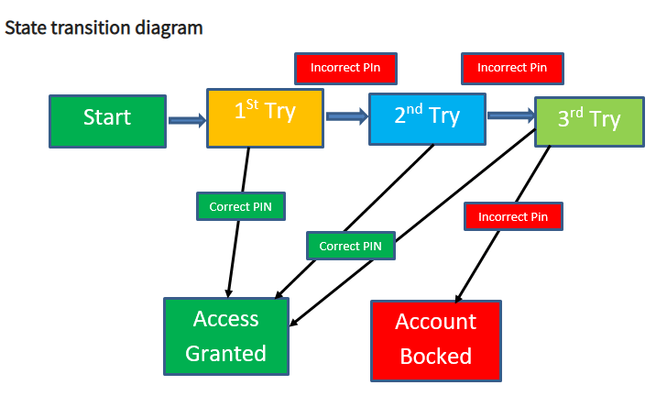
State Transaction Testing

Slide 16
State Transaction Testing
A use case is a description of a particular use of the system by an actor or user.
It is used widely in developing tests at system or acceptance level.
Use Case Testing is defined as a software testing technique, that helps identify test cases that cover the entire system, on a transaction by transaction basis from start to the finishing point.
Each use case is a process flow or scenario
The main parts of a Use Case are:
Actors
Pre conditions
Post conditions
users of the system
What are the starting requirements for the use case
The state the system will end up in once completed

Slide 17
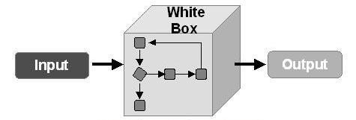
White Box Testing

Slide 18
White Box Testing
It is usually performed by developers.
White Box testing can be performed using 2 step
Step-1:Understand the code
Step-2:Create the test cases and execute it

Slide 19
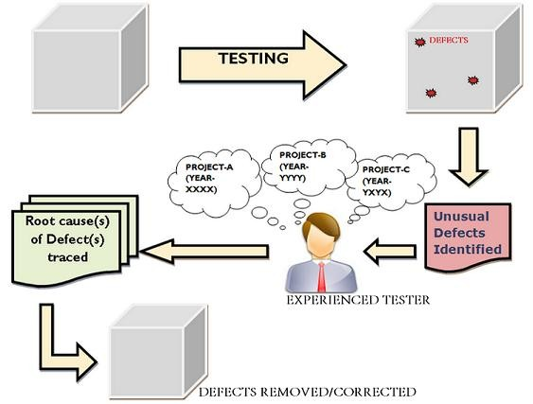
Experienced Based Testing

Slide 20
Experienced Based Testing
Introduction :
It is the technique of executing testing activities with the help of testers who verifies and validates the software product quality using his/her past experience of testing the similar type of product in the respective domain.
Experience based techniques are non structured and do not rely on specification documents.
In experience-based techniques, people’s knowledge, skills and background are of prime importance to the test conditions and test cases.
Experience Based Testing
Gray Box Testing
Ad-Hoc testing/Error Guessing
Exploratory
Testing

Slide 21
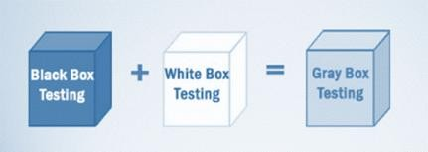
Grey Box Testing
Gray Box Testing is a software testing method, which is a combination of
both White Box Testingand Black Box Testing method.
Grey Box testing is a technique to test the application with limited knowledge of the internal workings of an application.
Unlike black box testing, where the tester only tests the application's user interface, in grey box testing, the tester has access to design documents and the database.

Slide 22
Adhoc Testing(Error Guessing)
Adhoc testing is an informal testing type with an aim to break the system. It does not follow any test design techniques to create test cases.
This testing is primarily performed if the knowledge of testers in the system under test is very high.
Main aim of this testing is to find defects by random checking.
Adhoc testing can be achieved with the testing technique called Error
Guessing.
Error guessing can be done by the people having enough experience on the system to “guess” the most likely source of errors.

Slide 23
Types of Adhoc Testing
There are different types of Adhoc testing and they are listed as below:
Buddy Testing
Two buddies mutually work on identifying defects in the same module. Mostly one buddy will be from development team and another person will be from testing team. Buddy testing helps the testers develop better test cases and development team can also make design changes early. This testing usually happens after unit testing completion.
Pair testing
Two testers are assigned modules, share ideas and work on the same machines to find defects. One person can execute the tests and another person can take notes on the findings. Roles of the persons can be a tester and scriber during testing.
Monkey Testing
Randomly test the product or application without test cases with a goal to break the system.

Slide 24
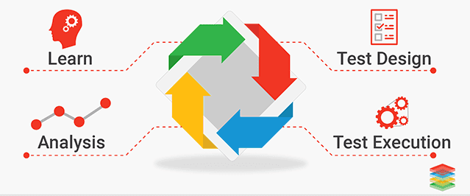
Exploratory Testing
It is a simultaneous learning, test design, and test execution process.
In this testing test planning, analysis, design and test execution, are all done together and instantly.
The tester will create or write down a test idea to give direction, and
explore the system while testing to further create critical, practical and
useful tests for the successful testing of an application.

Slide 25
Smoke Testing vs Sanity Testing
Smoke Testing | Sanity Testing
Smoke Testing is performed to ascertain that the critical functionalities of the program is working fine | Sanity Testing is done to check the new functionality / bugs have been fixed
The objective of this testing is to verify the "stability" of the system in order to proceed with more rigorous testing | The objective of the testing is to verify the "rationality" of the system in order to proceed with more rigorous testing
This testing is performed by the developers or testers | Sanity testing is usually performed by testers
Smoke testing is usually documented or scripted | Sanity testing is usually not documented and is unscripted
Smoke testing is a subset of Regression testing | Sanity testing is a subset of Acceptance testing
Smoke testing exercises the entire system from end to end | Sanity testing exercises only the particular component of the entire system
Smoke testing is like General Health Check Up | Sanity Testing is like specialized health check up

Slide 26
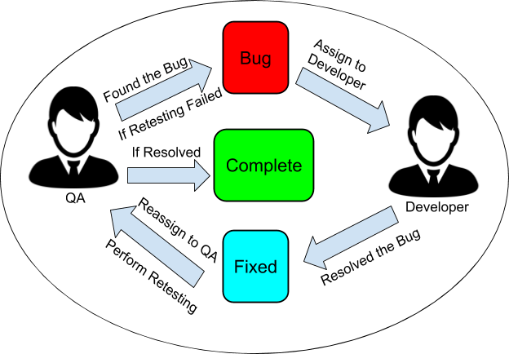
Re-Testing and Regression Testing
Confirmation Testing (Re-Testing)
Re-testing: Testing that runs test cases that failed the last time they were
run, in order to verify the success of corrective actions
Whenever a fault is detected and fixed then the software should be re-tested to show that the original fault has been fixed. This is known as Re-Testing.

Slide 27
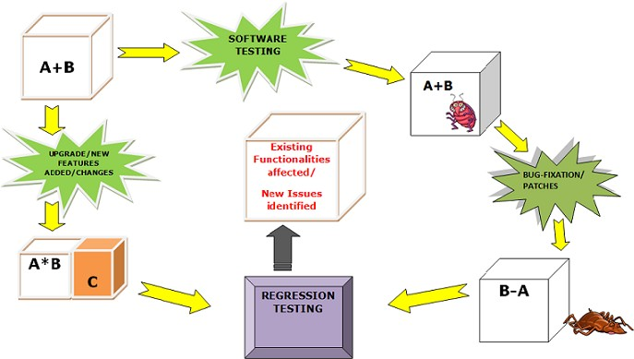
Regression Testing
Testing of a previously tested program following modification to ensure that defects have not been introduced or uncovered in unchanged areas of the software, as a result of the changes made. It is performed when the software or its environment is changed.

Slide 28
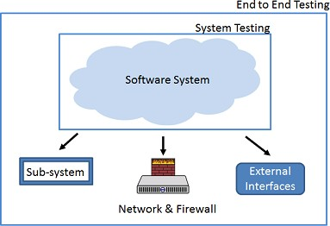
End to End Testing
Unlike System Testing, End-to-End Testing not only validates the software system under test but also checks its integration with external interfaces.
End to End Testing is usually executed after functional and system testing. It uses actual production like data and test environment to simulate real-time settings.
End-to-End testing is also called Chain Testing

Slide 29
Maintenance Testing
Maintenance testing: Testing the changes to an operational system or the impact of a changed environment to an operational system
testing changes to a Live System Triggered by, for example,
Modification
software upgrades
Operating system changes
system tuning
emergency fixes
Migration
System migration (including operational tests of new environment plus changed
software)
database migration

Slide 30


